Slide 1

Bangladesh Army University of Engineering & Technology (BAUET)
Department of Computer Science and Engineering
Thesis on
Outlier Detection on Data mining
Course Code : CSE-4200
Course Title : Thesis
Presented By
Name: MD. Touhid Iqbal Sagar
ID: 18204023
Batch: 8th
Department: CSE
Supervised by
Md. Muktar Hossain
Lecturer, Dept. of CSE,
BAUET

Slide 2
Outline
Introduction
Objectives
Literature review
Proposed methodology
Result analysis
Future Work
Conclusion
References

Slide 3

Introduction
Data Mining: Data mining is a process used to extract usable data from a larger set of any raw data.
Steps of Data mining:
Data Clustering
Data Integration
Data Reduction
Data Transformation
Data Mining
Pattern Evaluation
Knowledge Representation
Fig 01: Data mining example in real life

Slide 4


Introduction (Con’t)
Outlier: An outlier is a data point that differs significantly from other observations means
unusual observations
Fig 02: Outlier in a graph
Fig 03: Outlier in real life

Slide 5
Objectives
We are creating new robust outlier detection algorithm
Detecting outliers in a new way

Slide 6
Literature Review
V. J. Hodge and J. Austin, ‘‘A survey of outlier detection methodologies,’’Artif. Intell. Rev., vol. 22, no. 2, pp. 85–126, 2004. [Reference]
IQR / Box plot outlier detection method.
Data set = (22,25,17,19,33,64,23,17,20,18) [N=10]
Arrange the data ascending format = (17,17,18,19,20,22,23,25,33,64)
Q2 = (20+22)/2 = 21 Q1 = 18 Q3 = 25
Inter-Quartile Range (IQR) = Q3-Q1 = 25-18 = 7
Higher outlier = Q3+(1.5*IQR) = 25+(1.5*7) = 35.5
Lower outlier = Q1- +(1.5*IQR) = 18- +(1.5*7) = 7.5
So, Outlier = 64
Minimum value = 17
Maximum value = 33
Q1=18
Q2=21
Q3=25
Minimum=17
Maximum=33
Figure 04: Box Plot

Slide 7
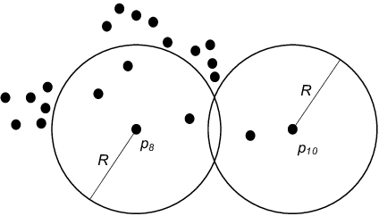
Literature Review Con’t
F. Angiulli, S. Basta, and C. Pizzuti, ‘‘Distance-based detection and prediction of outliers,’’ IEEE Trans. Knowl. Data Eng., vol. 18, no. 2, pp. 145–160, Feb. 2006 [Reference]
Distance based outlier detection method:
Distance based outlier detection method is supervised clustering algorithm, consults the neighborhood of an object, which is defined by a given radius.
Figure 05: Distance based outlier detection

Slide 8
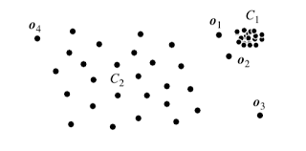
Literature Review Con’t
M. Breunig, H. Kriegel, R. T. Ng, and J. Sander, ‘‘LOF: Identifying density-based local outliers,’’ ACM SIGMOD Rec., vol. 29, no. 2,pp. 93–104, 2000. [Reference]
Density based outlier detection method:
Density based outlier detection method is unsupervised clustering algorithm, automatically detect patterns based on spatial location and the distance to a specified number of neighbors.
Figure 06: Density based outlier detection

Slide 9
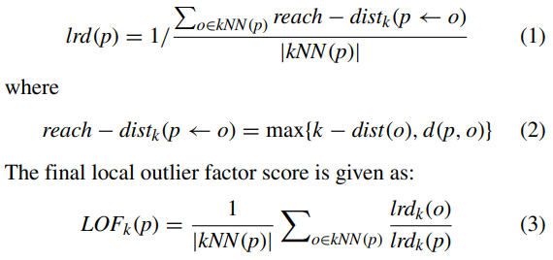
Proposed Methodology
M. Breunig, H. Kriegel, R. T. Ng, and J. Sander, ‘‘LOF: Identifying density-based local outliers,’’ ACM SIGMOD Rec., vol. 29, no. 2,pp. 93–104, 2000. [Reference]
Density based outlier detection method:
Where lrdk (p) and lrdk (o) are the local reachability density of p and o, respectively

Slide 10
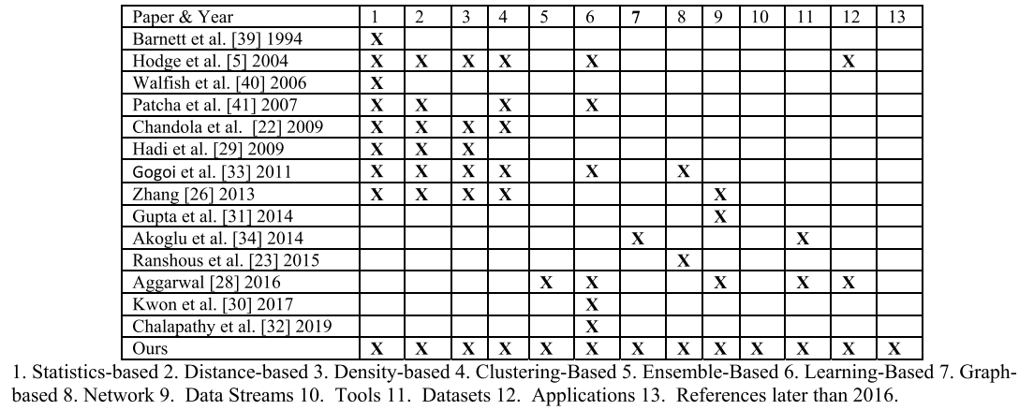
Result Analysis

Slide 11
Future Work
Data set implementation in real time

Slide 12
Conclusion
There is a huge data available in the world. With the needed data there also some unwanted or noisy data. My thesis is to detect the outlier or unwanted observations from the dataset and produce only the required data.

Slide 13
References
[1] J. Zhang, S. Zhang, K. H. Chang, and X. Qin, ‘‘An outlier mining algorithm based on constrained concept lattice,’’ Int. J. Syst. Sci., vol. 45, no. 5, pp. 1170–1179, May 2014.
[2] D. Hendrycks, M. Mazeika, and T. Dietterich, ‘‘Deep anomaly detection with outlier exposure,’’ 2019, arXiv:1812.04606. [Online]. Available: https://arxiv.org/abs/1812.04606
[3] J. Ren and R. Ma, ‘‘Density-based data streams clustering over sliding windows,’’ in Proc. Int. Conf. Fuzzy Syst. Knowl. Discovery (FSKD), Jul. 2009, pp. 248–252.
[4] M. Kontaki, A. Gounaris, A. N. Papadopoulos, and K. Tsichlas, ‘‘Continuous monitoring of distance-based outliers over data streams,’’ in Proc. IEEE 27th Int. Conf. Data Eng., Apr. 2011, pp. 135–146.

Slide 14

Thank You

Slide 15
Any questions?

